Slide 1

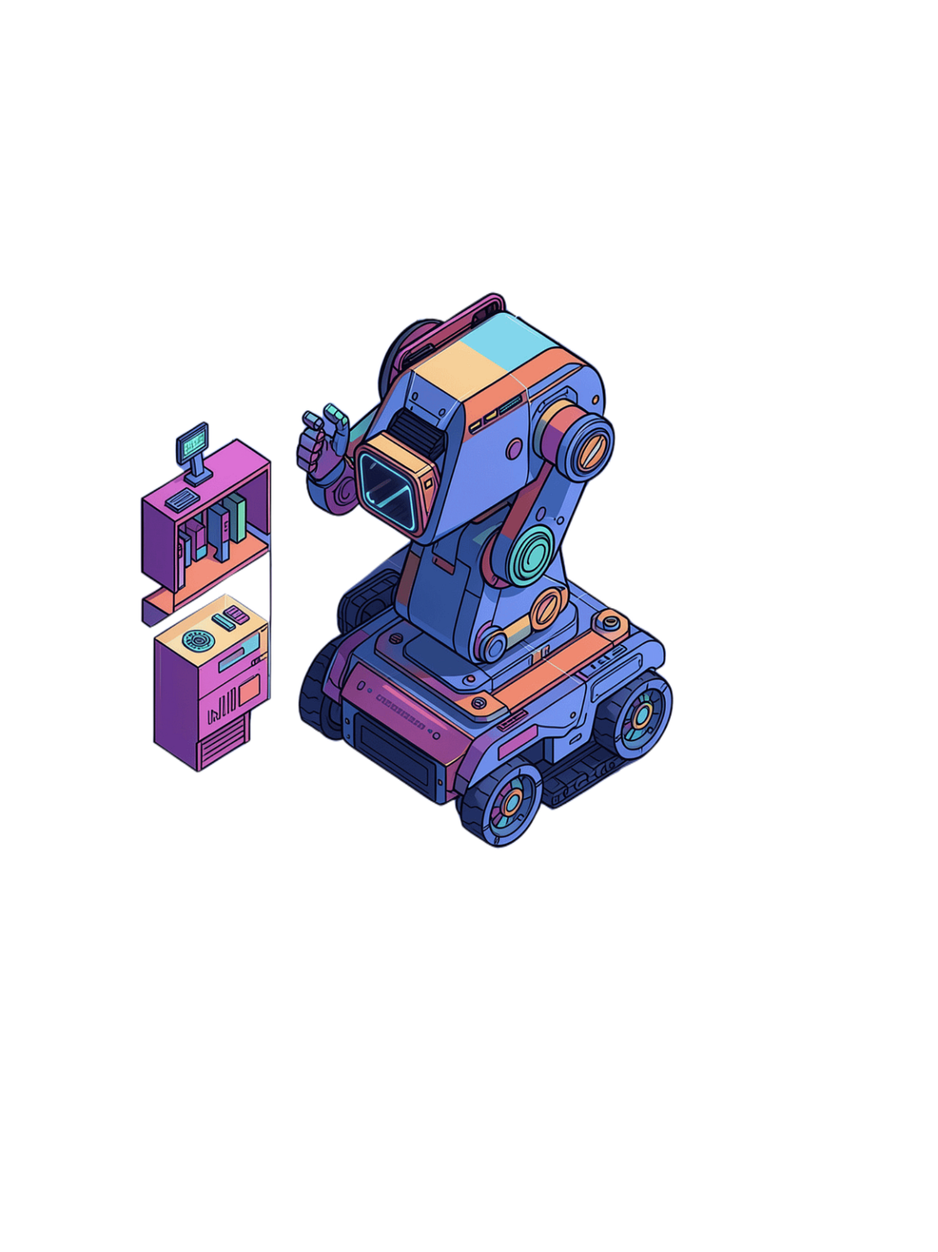
ROBOTICS
AUTONOMOUS SYSTEMS
Sensor-Based Navigation
An Academic Study of Autonomous Navigation Systems
Prepared by
ADITYA KATHANE :-27
YASHRAJ KENGAR:-28
PRIYANSHU YADAV:-67
NAVEEN YADAV:-68
MOHIT YEOLE:-69

Slide 2


What is Sensor-Based Navigation?
Navigation refers to the process of determining position and moving from one location to another with precision and control.
Sensor-based navigation enables autonomous systems to perceive their environment in real time and make intelligent decisions without human intervention.
Sensors provide the critical input that allows machines to interpret their surroundings, detect obstacles, and adapt to dynamic environments.
Key Process: Sense → Process → Decide → Move
This capability is fundamental to modern robotics and autonomous systems.

Slide 3


How Sensors Help Machines Navigate
Environment
Sensors
Processing
Decision
Movement
Control loop: sensors monitor the system state, the controller compares it with the target state, and corrective action reduces error.
Sensor-based navigation operates as a continuous feedback system. Environmental data is acquired through sensors, processed by the control system to extract relevant information, interpreted to determine the machine’s position and surroundings, and used to guide movement decisions. Actuators then execute the selected actions while sensors continuously verify the outcome. This closed-loop process repeats at high frequency, enabling real-time adaptation to changing conditions and supporting safe, reliable autonomous operation.
Environmental Detection
Signal Processing
Sensors scan the surroundings and collect raw data
Raw signals are converted into meaningful information
Decision Making
Motion Control
Position, obstacles, and next actions are evaluated
Motors are activated to support safe and efficient navigation

Slide 4
Types of Navigation Sensors
Navigation systems commonly integrate multiple sensing modalities to estimate position, detect obstacles, and support reliable motion in diverse operating conditions.
Ultrasonic Sensors
Infrared Sensors
LiDAR
Measure distance by emitting acoustic pulses and calculating time-of-flight from the returning echo.
Detect nearby obstacles using reflected infrared radiation and short-range proximity sensing.
Construct high-resolution three-dimensional environmental maps through laser-based scanning.
Camera
GPS
IMU
Support visual perception, feature extraction, and scene recognition for navigation.
Provide global positioning and outdoor localization through satellite-based signals.
Measure linear acceleration and angular velocity to track motion and orientation.
Wheel Encoder
Quantify wheel rotation to estimate displacement, speed, and relative movement.

Slide 5
Step-by-Step Navigation Process
01
02
Detect
Collect
Sensors continuously scan the environment to identify obstacles in real time
Data from multiple sensors is aggregated simultaneously
03
04
Process
Identify
The control system filters noise and analyzes signals to extract relevant information
The system determines position and maps key environmental features
05
06
Plan
Move & Loop
An optimal and safe trajectory is calculated toward the destination
Actuators execute movement commands while continuous sensor feedback enables adaptive control

Slide 6
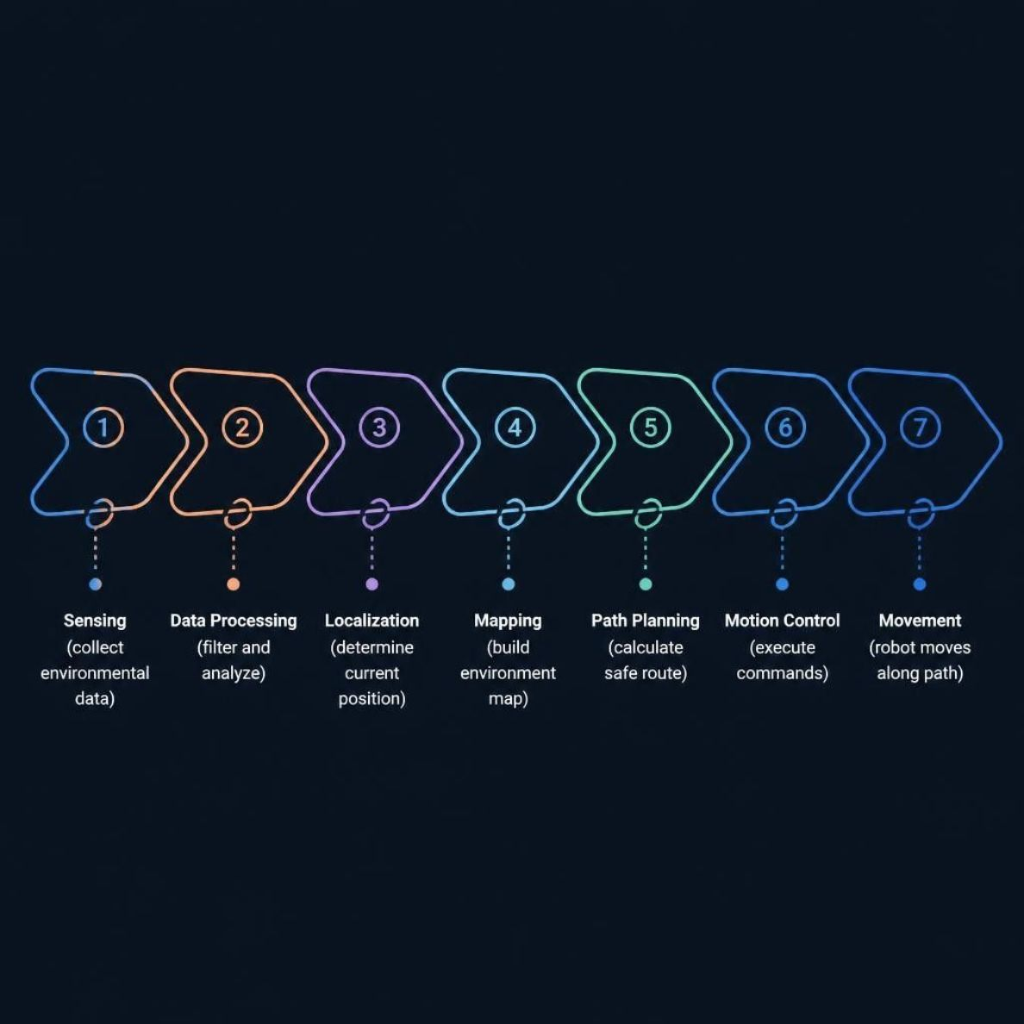
Navigation Pipeline
The navigation pipeline is a structured sequence of perception, computation, and control operations that enables autonomous robot motion. Each stage transforms environmental information into increasingly actionable outputs, culminating in safe, goal-directed movement.
Stage-by-Stage Overview
Sensing: Collect raw environmental data from onboard sensors
Data Processing: Filter noise and analyze signals to extract relevant information
Localization: Estimate the robot’s current position within the environment
Mapping: Construct or update a spatial representation of the surroundings
Path Planning: Compute the safest and most efficient route to the target
Motion Control: Translate the planned trajectory into actuator commands
Movement: Execute the path and travel through the environment
In autonomous navigation, each stage depends on the accuracy and reliability of the previous one. Sensing provides the raw inputs, processing refines them, localization and mapping establish situational awareness, and path planning with motion control produces coordinated movement. Together, these components support systematic, repeatable, and robust robotic navigation.

Slide 7
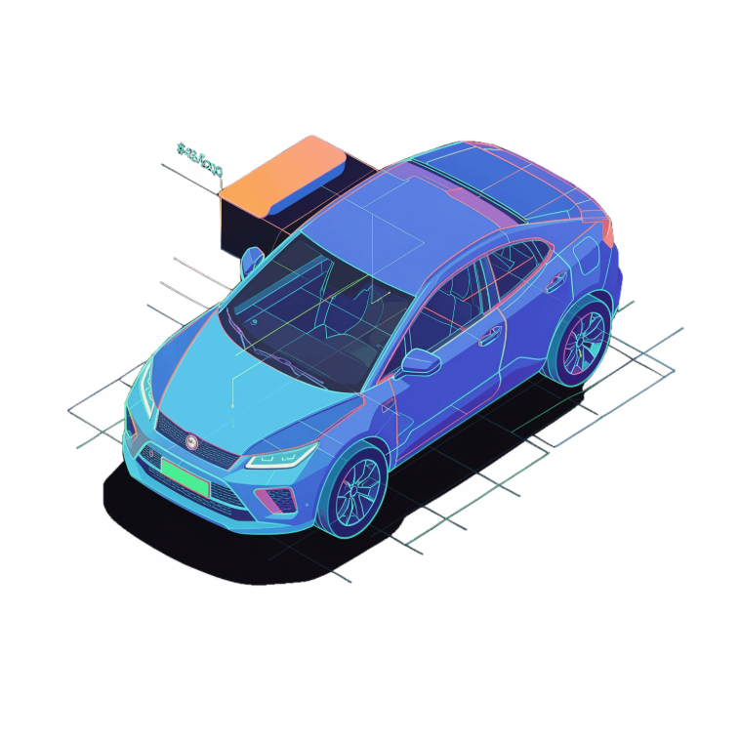
Navigation Methods
Obstacle Avoidance
Line-Following
GPS-Based Navigation
Real-time detection and dynamic avoidance of environmental obstacles
Trajectory tracking along predefined paths or visual markers
Global Positioning System (GPS) guidance for outdoor environments
Landmark-Based Navigation
Path Planning
SLAM
Pre-computed optimal trajectory generation prior to movement execution
Simultaneous Localization and Mapping enables autonomous exploration of unknown environments through concurrent position tracking and environmental mapping. Loop-closure detection corrects accumulated positional error and is essential for autonomous systems operating in unmapped or dynamic environments.
Navigation using recognition and localization of known environmental features

Slide 8
Sensor Fusion
Sensor fusion improves autonomous operation by integrating data from multiple sensors to compensate for the limitations of any single modality. By combining complementary measurements, robotic systems achieve more accurate, reliable, and robust perception and state estimation in complex environments.
Limitations of Individual Sensors
Why Sensor Fusion Is Effective
Kalman Filter Algorithm
Key Benefits
Improved accuracy and reliability
Robust performance across diverse environments
Supports autonomous operation under challenging conditions
GPS is unreliable indoors
LiDAR is computationally demanding
Cameras perform poorly in low-light conditions
Encoders accumulate drift over time
IMUs are affected by integration drift
Combines the complementary strengths of multiple sensors
GPS and IMU together provide continuous tracking
LiDAR and cameras support more robust perception
Encoders and IMUs help correct odometry drift
Weights each sensor according to its estimated reliability
Adapts confidence levels dynamically over time
Produces estimates with lower error than any single sensor alone

Slide 9
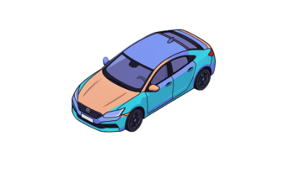
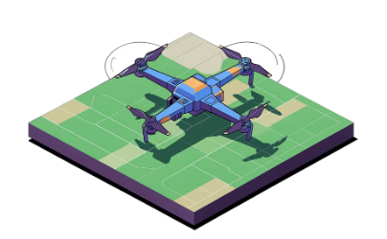
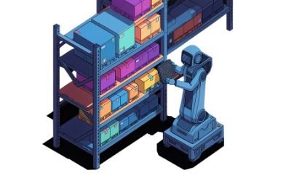
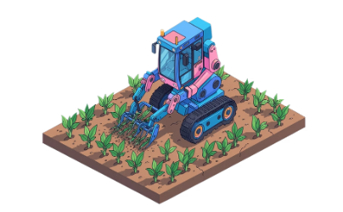
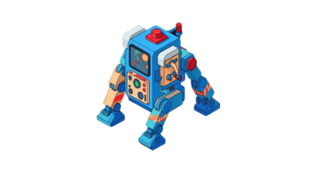
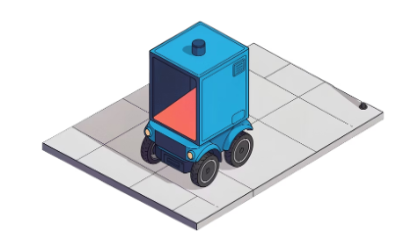
Real-World Applications
Sensor fusion underpins a wide range of autonomous systems by enabling reliable perception, localization, and decision-making in real-world environments.
Autonomous Vehicles
Unmanned Aerial Systems
Warehouse Robotics
Agricultural Robotics
Integrated perception and control for safe navigation in complex traffic conditions.
Autonomous aerial navigation with obstacle avoidance and mission execution capabilities.
Automated material handling and logistics in structured industrial environments.
Autonomous field operations for planting, monitoring, and harvesting.
Search and Rescue
Delivery Robots
Navigation in hazardous and unstructured environments for emergency response.
Last-mile autonomous delivery with urban navigation capabilities.

Slide 10
Advantages and Disadvantages
ADVANTAGES
DISADVANTAGES
Accuracy — consistent and repeatable navigation performance across diverse environments
Real-Time Detection — instantaneous obstacle identification and response capability
High Cost — significant capital investment required for quality sensor systems
Sensor Noise — environmental interference and measurement uncertainty affect accuracy
Autonomous Operation — independent operation without human intervention or control
Improved Safety — deterministic decision-making free from human fatigue and error
Environmental Limits — performance degradation in adverse weather and lighting conditions
GPS Limitations — satellite signals unavailable in indoor and underground environments
Reduced Human Effort — enables human operators to focus on higher-level strategic tasks
Processing Demand — substantial computational resources required for real-time processing and calibration

Slide 11
CONCLUSION
Sensor-based navigation represents a fundamental capability for autonomous systems operating in real-world environments. Through the integration of multiple sensing modalities, sophisticated data processing algorithms, and intelligent decision-making frameworks, robots and autonomous vehicles can perceive their surroundings, determine their position, and navigate safely without human intervention.
Key Takeaways
Sensors provide the critical sensory input that enables autonomous perception and awareness
Individual sensors have inherent limitations; sensor fusion overcomes these constraints
The Kalman Filter and related algorithms optimally combine sensor data for accurate state estimation
SLAM enables autonomous exploration and mapping of unknown environments
Diverse navigation methods address different operational requirements and environmental conditions
Real-world applications demonstrate the transformative impact of sensor-based navigation across industries
Future Directions
Advances in sensor technology, machine learning, and distributed computing continue to enhance autonomous navigation capabilities. As these systems become more sophisticated and reliable, sensor-based navigation will enable increasingly autonomous and intelligent robotic systems across transportation, logistics, agriculture, and emergency response domains.

Slide 12
THANK YOU
TEACHER SIGN
---------------------

